Slide 1
Simulated Weather Data Streaming: Testing Kafka, Spark, Cassandra Pipeline
Cindha Rizkiana

Slide 2
Background
Background: As we get more real-time weather data, we need a simple and efficient way to handle and process it using modern technologies.
Purpose: Build a reliable system that takes in live weather data from Kafka, analyzes it quickly with Spark, and stores it in Cassandra. This helps various industries access timely weather information for better decision-making.

Slide 3
Dataset
Objective: Gather real-time weather data for major cities in Taiwan.
Cities Included: Taipei, New Taipei, Taichung, Tainan, Kaohsiung, Taoyuan, Keelung.
Data Points Extracted:
Weather Condition
Temperature (in Celsius)
Humidity Percentage
Wind Speed
Timeframe: Continuous data extraction for current and upcoming weather conditions.

Slide 4
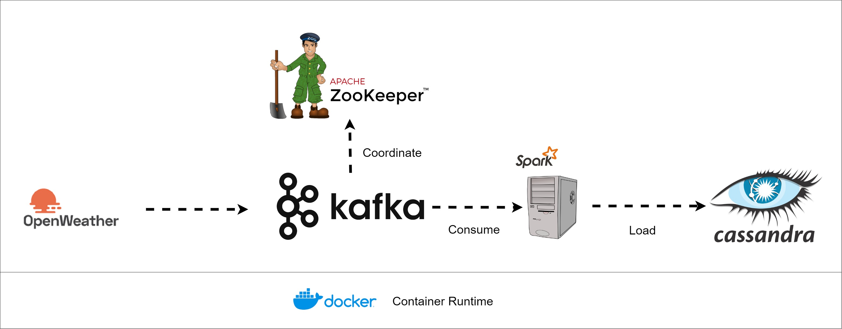
ETL Process

Slide 5
Thank You

